Slide 1
“If failure is not an option, then neither is success.” - Seth Godin
Failure is an Option:
Helping Your Students Make their Mistakes Work for Them
Tiera S. Coston, J.D., Ph.D.
Notes:
1) Seth Godin is an entrepreneur and author. He focuses on business and marketing.
2) This quote sets the stage for our discussion today.

Slide 2
Laying the Foundation
Accept mistakes and failure as a part of the learning process.
The ultimate goal is the students’ mastery of the subject matter.
Students will require ample and frequent feedback.
Teach Thought Staff (2012, November 9). Re: 10 Ways to Honor Mistakes in the Learning Process. Retrieved from http://www.teachthought.com/learning/10-ways-to-honor-mistakes-in-the-learning-process/ (te@chthought).
Notes:
Perfection is not the road to mastery; expect and embrace mistakes and failure.
This reflective journey will require a lot of input from you.

Slide 3
Laying the Foundation
No guarantee in outcomes due to diversity in students and their motivations.
Any changes made will take time to both carry out and take effect.
Teach Thought Staff (2012, November 9). Re: 10 Ways to Honor Mistakes in the Learning Process. Retrieved from http://www.teachthought.com/learning/10-ways-to-honor-mistakes-in-the-learning-process/ (te@chthought).
Notes:
We do not deal with a monolithic body of people in the classroom.
It will take time to see the fruits of you effort – that paradigm shift.

Slide 4
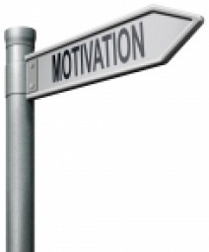
Student Motivation
Intrinsic motivation for learning involves on or more of the following:
curiosity
the drive to achieve competence
desire to emulate a model
Reciprocity (the need to work together with others to accomplish an objective)
Brookhart, S.M. (2010, July 20). Influence of Grading Practices on Motivation to Learn. Retrieved from http://www.education.com/reference/article/influence-grading-practices-motivation/.
Notes:
1) By facilitating a mindset change about failure and mistakes, we are looking to spark an intrinsic drive to learn.

Slide 5
Student Motivation
Four General Categories of Students
Overstrivers
Motivated to learn, but also motivated to avoid failure
Success is used as a strategy to avoid failure
Grades tell them how well they have succeeded
Always looking to out-do their previous success
Failure-accepting
Unmotivated to learn or to avoid failure
Bad grades are not a motivator to try
Presence in school is unrelated to success or failure
Brookhart, S.M. (2010, July 20). Influence of Grading Practices on Motivation to Learn. Retrieved from http://www.education.com/reference/article/influence-grading-practices-motivation/.
Notes:
1) Not only are you dealing with different drivers of motivation, you’re dealing with different student personalities.

Slide 6
Student Motivation
Four General Categories of Students
Failure-avoiding
Unmotivated to learn, but motivated to avoid failure
Set impossible, high goals and justify being unable to meet them
Grades are most important and a measure of self-worth
Success-oriented
Motivated to learn, but not necessarily to avoid failure
Risk failure in an effort to learn
View failure as feedback that a goal is not yet mastered
View grades as information to be used in their learning
Brookhart, S.M. (2010, July 20). Influence of Grading Practices on Motivation to Learn. Retrieved from http://www.education.com/reference/article/influence-grading-practices-motivation/.

Slide 7
Student Motivation
Attribution Theory
Search for understanding is the basic source of motivation; an understanding of what brings about an outcome or event in the classroom
Students identify causes of various classroom events along three dimensions
Stability – whether the cause was changeable over time
Locus – whether the cause was internal or external to the student
Control – whether the student had control over the cause
Brookhart, S.M. (2010, July 20). Influence of Grading Practices on Motivation to Learn. Retrieved from http://www.education.com/reference/article/influence-grading-practices-motivation/.
Notes:
Students want to understand why things happen, e.g. why they failed the exam.
They identify the causes of different classroom events along three different facets – stability, locus and control
If a student recieves an “F” on an exam and thinks that happened because the professor was unclear in writing the exam questions, that causal attribution would be defined as unstable (the professor may write clearer exam questions in the future); external (it’s not that I didn’t know the material, the questions were not clear) and uncontrollable (the professor wrote the unclear questions).
In attempting to change thinking, we want students to view causal events as unstable, internal and controllable.

Slide 8
Defining Mistake and Failure
Mistake
noun – something that is not correct; a wrong action, statement, or judgment
verb – to understand or identify incorrectly; to make a wrong judgment about
Failure
a state of inability to perform a duty or expected action; lack of success
mistake. 2014. In Merriam-Webster.com . Retrieved September 5, 2014 from http://www.merriam-webster.com/dictionary/mistake?show=0&t=1410286909
failure. 2014. In Merriam-Webster.com . Retrieved September 5, 2014 from http://www.merriam-webster.com/dictionary/failure
Notes:
So now that we’ve laid a foundation about what we’re dealing with, let’s look at how society (and consequently students) view mistakes and failure.

Slide 9
Student Responses to Mistakes/Failure
What we typically see . . .
Anxiety
Humiliation
Panic
Guilt
Defeatedness
Anger
Frustration
Apathy
What we want to see . . .
Opportunity
Motivation
Agrell, Jeffrey (2012). Re: The Value of Mistakes. Retrieved from http://www.uiowa.edu/~somhorn/resources/resources/resouces/articlesvalue.html (Horn Studio of the University of Iowa).

Slide 10
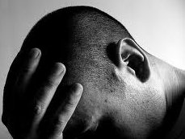
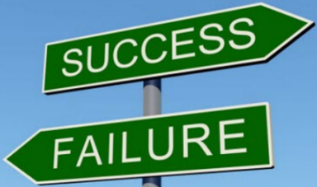
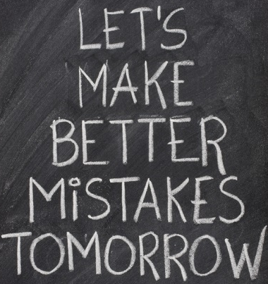
Redefining Mistake and Failure
We must change students’ attitudes and perceptions about their mistakes and failures.
This requires a shift in the culture in which most students have been educated.
Educators have the power to redefine the culture in their classrooms.
Maats, H. and O’Brien K. (2014, March 20). Re: Teaching Students to Embrace Mistakes. Retrieved from http://www.edutopia.org/blog/teaching-students-to-embrace-mistakes-hunter-maats-katie-obrien (Edutopia).
Notes:
1) The sign shows “success” and “failure” in opposite directions, but the change in thinking will involve students understanding that “success” and “failure” travel a concurrent path. To achieve success, one must encounter failure.

Slide 11
Embracing Mistakes/Failure
Does not mean accepting. . .
Laziness
Lack of Effort
Failure as an end result
Mediocrity
It does mean using mistakes as a part of a discovery process that engages students and ultimately leads to achieving mastery.
Clifford, Miriam (2012, November 6). Re: The Value of Mistakes: Should It Matter How Long A Student Takes to Learn? Retrieved from http://www.opencolleges.edu.au/informed/features/the-value-of-mistakes-should-it-matter-how-long-a-student-take-to-learn/ (informEd).
Notes:
One can envision this process devolving into a situation where mistakes and failure are ignored. We don’t want to ignore them, but we want to use them.

Slide 12
Practical Approaches
Metacognition
Talk About It
Assess It
Review and Reflection
Notes:
So, all of this sounds great, but how do you foster this culture shift in your classroom?
I want to reiterate that this is a “trial and error” process whose positive outcomes ebb and flow.

Slide 13
Talk About It
Metacognition – Understanding one’s own process of learning and using that understanding to plan, monitor and assess learning (understanding and performance)
Communicate to your students that:
1) they are going to make mistakes; and
2) understanding the nature of those mistakes can be the key to mastering concepts.
Excerpt from Dr. Jeremy D. Cohen’s syllabus, PSYC 1010, Fall 2014
Bransford, J.D., Brown, A.L. and Cocking, R.R. (eds.) 2000. How People Learn Brain, Mind, Experience, and School. National Academy Press, Washington, D.C.

Slide 14
Assess It
Make mistakes/failure a natural part of the learning process in your classroom by . . .
Encouraging students to share errors on exams and graded assignments
Prompt students who provide wrong answers during class discussions to analyze why their answers were wrong
Generally, students are programmed to avoid failure.
Attaching a grade to the process of learning to fail effectively and efficiently can encourage the paradigm shift.
Burger, Edward (2012, August 12). Re: Teaching to Fail. Retrieved from https://www.insidehighered.com/views/2012/08/21/essay-importance-teaching-failure (Inside Higher Ed).
Notes:
At the beginning of this workshop, you told us that we want to foster intrinsic learning in students. Why are you now telling us to attach a grade to the process?
Although grades are a type of extrinsic motivation, they are not fatal to the process. It’s how you do it that makes the difference.

Slide 15
Review and Reflection
Ogle, D.M. (1986). K-W-L: A teaching model that develops active reading of expository text. Reading Teacher, 39, 564-570.
Notes:
If this looks familiar, it’s a modification of the RAN (Reading and Analyzing Nonfiction) Strategy to help students engage in active reading, which is based on Ogle’s K (Know)-W (Want to Know) –L (Learned or want to learn) table.

Slide 16
Review and Reflection
Ogle, D.M. (1986). K-W-L: A teaching model that develops active reading of expository text. Reading Teacher, 39, 564-570.
Notes:
If this looks familiar, it’s a modification of the RAN (Reading and Analyzing Nonfiction) Strategy to help students engage in active reading, which is based on Ogle’s K (Know)-W (Want to Know) –L (Learned or want to learn) table.

Slide 17
Review and Reflection
Ogle, D.M. (1986). K-W-L: A teaching model that develops active reading of expository text. Reading Teacher, 39, 564-570.
Notes:
If this looks familiar, it’s a modification of the RAN (Reading and Analyzing Nonfiction) Strategy to help students engage in active reading, which is based on Ogle’s K (Know)-W (Want to Know) –L (Learned or want to learn) table.

Slide 18
Thank You!
This presentation will be posted to the:
CAT Wiki – xulacat.wikispaces.com
CAT Food Blog – cat.xula.edu/food/

