Slide 1
Improving Student Performance by Addressing Student and Teacher Misconceptions about Learning
Stephen L. Chew, PhD
Department of Psychology
Samford University
slchew@samford.edu Twitter: @SChewPsych
Xavier University
July 7, 2015

Slide 2
Goals for this Session
Discuss common teacher and student misconceptions about learning
Discuss cognitive principles of learning students need to understand to become more effective learners.
Discuss cognitive principles of learning teachers should know to improve pedagogy
Discuss how to put principles into practice using formative assessments and exam wrappers

Slide 3
Three Kinds of Knowledge for Effective Teaching
Knowledge of
Your Field
Effective
Teaching
Knowledge
Of How People
Learn
Knowledge of How
People Learn
Your Field

Slide 4
Teacher Beliefs about How People Learn
Teaching requires a mental model of how people learn.
Determines which teaching methods are selected, how they are implemented and assessed, and how to adjust if there are problems.

Slide 5
Student Beliefs about How People Learn
Students also base their study behavior based on their models of how people (specifically themselves) learn.
It determines their learning effectiveness, achievement, and success
Notes:
Whether or not they go to class,
If and how well complete assignments,
How they study and when material is mastered

Slide 6
A typical incoming college student…
Has graduated from high school with an average GPA of 3.00 (NAEP, 2009)
Has probably passed a high school exit or graduation exam
Has been tested for scholastic achievement or aptitude many times
Probably taken an entrance exam and was admitted to college

Slide 7
% of Students Deemed Ready for College by ACT (2014)
Notes:
Only the ACT reports College Readiness Benchmark Scores – A benchmark score is the minimum score needed on an ACT subject-area test to indicate a 50% chance of obtaining a B or higher or about a 75% chance of obtaining a C or higher in the corresponding credit-bearing college courses, which include English Composition, Algebra, Social Science and Biology. These scores were empirically derived based on the actual performance of students in college. The College Readiness Benchmark Scores, updated for 2013, are:
College Course/Course Area ACT Test Benchmark Score
English Composition English 18
Algebra Mathematics 22
Social Sciences Reading 22
Biology Science 23

Slide 8
A typical college freshman is
Inadequately prepared for college work
Unaware of the fact because it is contrary to their successful high school experience
Likely overconfident in their preparation and abilities for college-level work
Few students enter college believing they will struggle
Notes:
Many students will struggle academically in their first year of college
Culture of access vs. culture of completion
Overconfidence may hinder their recognition and willingness to try to make the necessary changes
Even when willing to change, they do not know what changes to make (or not make)
Some percentage of these students will not succeed in college even though they have the ability to do so
A larger percentage will perform poorly as they adjust to college level study

Slide 9
Typical Student Messages
“I came into the test really confident that I knew the material but it didn't show that on the test.”
“The reason I have stuck with the course this long is because I believe I have put a lot of effort towards studying for the exams is just I haven't tested well.”
“I felt prepared going in to the first two exams but scored much lower than I wanted to (and much lower than the class). To be completely honest, I have not wanted to come to class because I do not feel it is worth it if I am not going to do well anyways.”
Notes:
What beliefs are reflected here? Overconfidence. Lack of metacognitive understanding. On number 2, had never come to see me; had never come to review exam. Misconception of effort and relation to grade. May not be doing the right kind of effort. Not doing well so don’t want to go to class. A response to failure that will lead to more failure.

Slide 10
The Primary Goal of Teaching
Either
To present information that students are solely responsible for learning
Or
To develop a sophisticated, useful, and generative level of understanding on the part of the students
Distinguish between teaching that makes it easy for students to learn vs. teaching that makes it easy to make a good grade
Notes:
If To present information that students are solely responsible for learning
Teaching is easy, it only takes content knowledge, no special training.
Be accurate, organized and interesting.
student adjustment to college level work is not the teacher’s problem
The teacher cannot or should not influence learning (watering down)
Good teachers are popular, easy, or funny
Or
To develop a sophisticated, useful, and generative level of understanding on the part of the students
Define success in terms of student learning
In which case student adjustment to college level work is the teacher’s problem
Teachers share responsibility for student learning
Teaching becomes a difficult skill

Slide 11
How to help students make a successful transition to college
Remediation
Teach them to adjust through college transition courses, advising, study skills centers, and other resources
Personal and social adjustment; study “tips”, and time management
Teach them how to be more effective learners by correcting misconceptions and teaching them cognitive principles of learning
Notes:
Both Students and Teachers often base their actions on untested assumptions, informal intuition, and faulty beliefs about how people learn These misconceptions undermine student learning
Talk about common misconceptions of teachers and students
Not just about content like remediation

Slide 12
Video Series: How to Get the Most Out of Studying http://www.samford.edu/how-to-study/

Slide 13
The Challenges
Overcome student misconceptions about learning
Give students a coherent, research-based framework for developing effective learning strategies in any situation
More than disconnected study tips
Show them how to apply the framework to their study
Make the videos engaging, accessible, and memorable
Do it in 5 7-minute videos
Notes:
Student preconceptions about college advice
Students expect to be lectured to about how hard college is going to be and how hard they will have to work.
“I’m a college professor and you better study hard because college is tough!”
“Look to your left…”
e.g. space out learning; serial position; study in same place you will be tested
Not a recipe for best way to study

Slide 14
How to Get the Most Out of Studying Webpage: http://www.samford.edu/how-to-study/
Introductory Video: Developing a Mindset for Successful Learning
Video 1: Beliefs That Make You Fail…Or Succeed
Video 2: What Students Should Understand About How People Learn
Video 3: Cognitive Principles for Optimizing Learning
Video 4: Putting the Principles for Optimizing Learning into Practice
Video 5: I Blew the Exam, Now What?

Slide 15
Beliefs about Learning that Make You Stupid
Learning is fast
Being good at a subject is a matter of inborn talent rather than hard work,
Knowledge is composed of isolated facts
I’m really good at multi-tasking, especially during class or studying
Notes:
Typical beliefs or comments: “One good reading is enough” or “I read 8 chapters last night”
You learn more during review than you do at initial reading
Students, especially weak students, grossly underestimate the time required to complete assignments
As a result, they start studying or working on assignments too late
I do it all the time, so I must be good at it
Study while monitoring texts, checking facebook, watching videos, carrying on conversations
Any distraction takes away from our ability to concentrate and learn
Virtually no one is good at multitasking
Typical beliefs and comments:
“I’m bad at math.”
“Maybe this time I’ll get lucky”
Belief in fixed intelligence, vs. malleable intelligence
Often reinforced by feedback, “You are smart” or “Science is just not your thing”
Study by memorizing facts in isolation of each other
Highlighting bolded terms in the text, then studying those

Slide 16
Attentional Blink
Switching attention is time consuming and effortful
20 alerts and you’ve wasted an hour (without checking anything)
The average Facebook visit is about 20 minutes
3 visits and you’ve wasted an hour
Checking texts, twitter, etc. wastes at least a few minutes every time
There is no such thing as a momentary distraction
Notes:
Look up driving and texting to find average text time.

Slide 17
Metacognition
A student’s awareness of his or her level of understanding of a topic
Metacognition distinguishes between stronger and weaker students
One of the major tasks for a freshman is developing good metacognition
In high school, students spent years developing a metacognitive sense that is likely inadequate or even counterproductive for college.

Slide 18
Self-Rating
What is your best, most accurate judgment of the percentage of questions that you answered correctly on this exam? Your answer may range from 0 to 100%
_____________________% correct

Slide 19
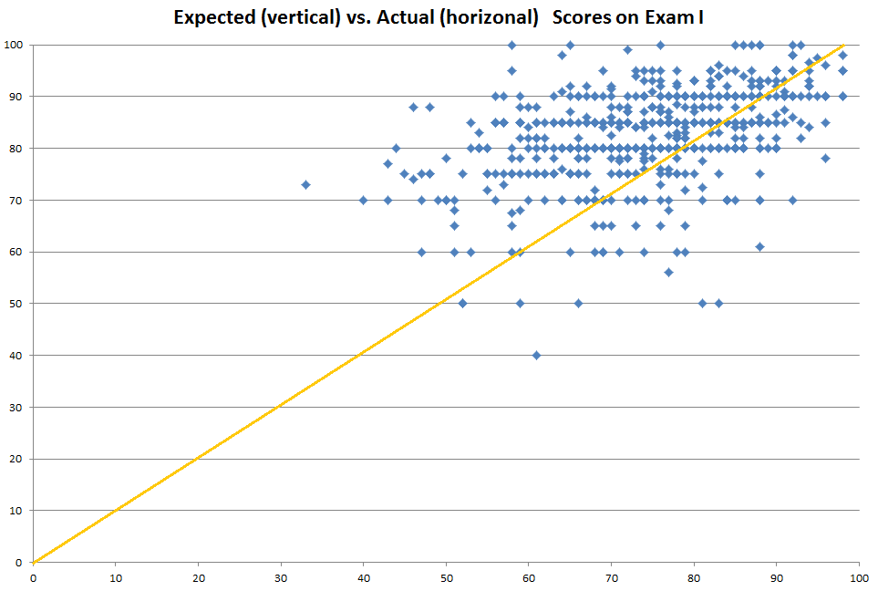
Estimated and Actual Grades for 800 Students: Econ 101

Slide 20
The irony of poor metacognition
Students who have the poorest metacognition have no clue how weak their understanding of a concept is.
Part of being incompetent is not understanding just how incompetent you are.
So the students who most need to listen closely to this talk are the ones who don’t believe they need to.
(The same holds true for teachers)
Notes:
Same goes for teachers. Teachers who most need to improve are ones that don’t think they do. A common finding; big part of incompetence is not realizing how incompetent you are. Really, it is a critical learning skill. There is probably a lot about this that I don’t know.

Slide 21
So how accurate are your beliefs about how people learn?

Slide 22
Which of the following is the MOST important ingredient for successful learning?
The intention and desire to learn
Paying close attention to the material as you study
Learning in a way that matches your personal Learning Style?
The time you spend studying
What you think about while studying
Notes:
Do by hand. How is this different than clicker questions.

Slide 23
Read the instructions for the demonstration to yourselves and do your best to follow them.

Slide 24
Rate each word
Does the word contain an E or G?
Do you find the word Pleasant?
Notes:
24
Orienting Task Demonstration
Between Groups:
Divide the class into two groups. Have Group one prepare a two column answer sheet labeled unpleasant and pleasant. Have the other group label theirs E/G yes or no. Read the list at about 2 seconds/word. Then give a recall task. This works intentionally or incidentally.
1. Evening 13. Cold
2. Country 14. Love
3. Salt 15. Bargain
4. Easy 16. War
5. Peace 17. Hate
6. Morning 18. Wet
7. Pretty 19. Rich
8. Expensive 20. Nurse
9. Poor 21. Pepper
10. Doctor 22. Hard
11. City 23. Ugly
12. Dry 24. Hot
Now turn your paper over and write down as many words as you can recall.
Use a show of hands to see how many words each person recalled. Also, ask if people noticed that the words were composed of associates. This finding is very robust, and does not depend on incidental learning.

Slide 25
Levels of Processing
Shallow processing focuses on spelling, appearance and sound.
Rote memorization of facts
Flashcards with isolated facts
Deep processing focuses on subjective meaning.
Relating new information to prior knowledge or other information
Making information personally meaningful

Slide 26
Rate each word
Does the word contain an E or G?
Do you find the word Pleasant?
Shallow processing: You are
focusing on spelling.
Deep processing: You are
relating the words to your
own meaningful experiences.
These are orienting tasks that cause you
to think in deep or shallow ways,
regardless of your intention
Notes:
26
Orienting Task Demonstration
Between Groups:
Divide the class into two groups. Have Group one prepare a two column answer sheet labeled unpleasant and pleasant. Have the other group label theirs E/G yes or no. Read the list at about 2 seconds/word. Then give a recall task. This works intentionally or incidentally.
1. Evening 13. Cold
2. Country 14. Love
3. Salt 15. Bargain
4. Easy 16. War
5. Peace 17. Hate
6. Morning 18. Wet
7. Pretty 19. Rich
8. Expensive 20. Nurse
9. Poor 21. Pepper
10. Doctor 22. Hard
11. City 23. Ugly
12. Dry 24. Hot
Now turn your paper over and write down as many words as you can recall.
Use a show of hands to see how many words each person recalled. Also, ask if people noticed that the words were composed of associates. This finding is very robust, and does not depend on incidental learning.

Slide 27
Intention vs. Level of Processing

Slide 28
Which of the following is the MOST important ingredient for successful learning?
The intention and desire to learn
Paying close attention to the material as you study
Learning in a way that matches your personal Learning Style?
The time you spend studying
What you think about while studying

Slide 29
Implications for Learning
Intention and motivation to learn are not important
Attention and amount of study is necessary, but not sufficient for learning
Learning strategy has a huge impact on learning
Shallow study strategies trump good intentions
Deep level of processing is critical for learning

Slide 30
Implications for Students
Many students have highly practiced poor learning strategies
Studying more won’t help
Increase overconfidence without learning
They need to unlearn highly practiced old strategies and develop new, more effective ones
Consider study skills in terms of orienting tasks and level or processing
Notes:
Long, effortful process to unlearn old strategies and learn more effective ones. No instant success. Can’t try it for one afternoon and expect to see success. Each student must find the best strategy for a particular topic. There will be setbacks in doing so.

Slide 31
These findings are strongly counterintuitive
All study is effective, only amount, intensity, and desire matter
Motivation automatically improves study effectiveness
Effort equals learning
Learning is hard work, but not all hard work leads to learning
Notes:
Not all study is the same; some is useless and some is counterproductive
Motivation without deep processing is ineffective
The more I study, the more I learn

Slide 32
Implications for Teachers
Teaching skill matters, and matters greatly
Pedagogy has a significant impact on learning, for better or worse
Consider pedagogy in terms of orienting tasks and level of processing
Design assignments, problem sets, questions, examples to induce deep processing
Notes:
Teachers matter and matter greatly
What does this activity make students think about?
A badly designed assignment isn’t just useless, it can undermine learning

Slide 33
Achieving Deep Processing while Studying
As you study, follow these principles:
Elaboration: How does this concept relate to other concepts? Can I make a story?
Distinctiveness: How is this concept different from other concepts?
Personal: How can I relate this information to my personal experience?
Appropriate to Retrieval and Application: How am I expected to use or apply this concept?
Notes:
These properties lead to development of connected understanding

Slide 34
These are principles for deep processing, but not a recipe
There is no set recipe for effective studying or effective teaching
What constitutes effective study will depend on the student, the subject, and the assessment
What constitutes effective teaching will depend on the teacher, the students, their mindset, the subject, and the learning goal

Slide 35
So shouldn’t we design pedagogies that make students use deep processing all the time? (What faculty need to know about learning)

Slide 36
What are the critical factors in student learning?
Engagement
Active learning
Struggle
Many faculty take pride in how hard they make students struggle
Assumes struggle leads to better learning
Notes:
These are educational terms with no exact psychological meaning. Already dealt with fact that engagement and active learning are not guarantees of learning.

Slide 37
Cognitive Load Theory (e.g. van Merrienboer & Sweller, 2005)
Mental effort is the amount of concentration that a person has available to devote to tasks
Mental effort is always a limited resource
Cognitive Load is the total amount of mental effort a task requires to complete it
A person can do multiple tasks at once as long as the total cognitive load does not exceed available mental effort
If cognitive load exceeds available mental effort, then performance suffers

Slide 38
Student mental effort must meet the demands of instructional cognitive load
Available
Mental Effort
Cognitive Load
of Teaching
Extraneous Load
Teachers
design
instruction
Germane Load
Must be
less than
Limited
Resource
Intrinsic Load
Tasks and concepts
possess difficulty

Slide 39
Name the days of the week out loud and in order as fast as you can

Slide 40
About this Activity
Were you engaged?
Were you engaged in active problem solving?
Were you working hard and struggling?
What was the 4th day in the list?

Slide 41
Name the Days of the Week as Quickly as You Can
In Alphabetical Order
Friday
Monday
Saturday
Sunday
Thursday
Tuesday
Wednesday
Notes:
How many people didn’t even try because it was too hard and you didn’t think it was worth the effort? What do you do when students tell you that?
Piece of advice: Study Harder! How useful is that? Not useful, but we tell students that all the time.

Slide 42
Implications of Cognitive Load Theory
If the cognitive load demanded of students exceeds their available mental effort, then learning will not occur
If the cognitive load demanded of students takes up most or all of available cognitive effort, then there will not be enough mental effort available for learning or schema formation
Teachers must monitor, manage and minimize cognitive load to allow schema development as well as design activities to promote schema development
Notes:
Can complete a task successfully but learn nothing from it if it took all of cognitive load. Schema formation is effortful.

Slide 43
Deep Processing and Cognitive Load
Deeper level of processing causes better learning (good) but also greater cognitive load (bad)
All “High Impact” practices have high cognitive load
Shallow Processing
Less Learning
Less Cognitive Load
More Learning
More Cognitive Load
Deep Processing

Slide 44
Cognitive Load of Various Tasks (adapted from Piolat, Olive & Kellogg, 2004)

Slide 45
How do we deal with cognitive load?
Deliberate Practice leads to automatic thinking
Deliberate practice is intentional practice with the goal of improving a skill.
Not mindless drill
The goal must be apparent to the student, or the student must trust the teacher
With large amounts of practice, a skill becomes automatic and no longer requires metal effort.
Expertise is based on automatic processing
Notes:
Practice beyond simple competence. More than students think necessary. Math

Slide 46
About Engagement, Active Learning, and Struggle
Engagement, active learning, and mental struggle do not always lead to effective learning
Neither does deep processing if cognitive load is too great
Teachers must balance deep processing and cognitive load

Slide 47
The Complexity of Teaching
The number of teaching methods is large and diverse
No teaching method is without limitations and pitfalls
Teaching is a contextual interaction; Teaching effectiveness involves the dynamic interaction of multiple factors:
the outcomes that are desired by
the characteristics of the students by
the characteristics of the instructor by
the curriculum and content
No single best way to teach
Notes:
Cannot define good teaching by method used.

Slide 48
The TACOMA Model of Teaching (Teaching as a Contextual Outcome of Multiple Agents)
Characteristics of the Teacher
In-the-Moment
Reflection
Pre-event
Reflection
Topic, Content, and
Learning Goals
Monitor,
Manage,
Manipulate
Manipulate
Monitor
Manipulate
Teaching
Strategies
Learning
Strategies
Characteristics
of the Learner
Form of
Assessment
Level of Student
Understanding
Post-event Reflection
Student-Teacher Rapport
and Classroom Atmosphere

Slide 49
An Effective Teacher
Must monitor, manage, and manipulate multiple, conflicting factors, many of which are outside the teacher’s control, to achieve desired learning goals
Must be knowledgeable about multiple teaching methods and make adjustments during teaching.
Notes:
There is no pedagogy that can’t go wrong
There is no pedagogy that a great teacher can’t figure out how to make successful

Slide 50
Take Home Message, Part 1
Students and faculty have misconceptions about learning that undermine effectiveness
Presented a more sophisticated understanding of how people learn
Teaching is a complex interaction of factors that the teacher must manipulate, manage, and monitor
Notes:
Levels of Processing and orienting tasks
Cognitive Load
Must keep them in balance
No single best teaching method
Requires constant monitoring and adjustments

